Slide 1
Machine Learning Street Talk
The MLP Assumption, Inductive Biases, Self-organizing/Coordinating Networks
Presented By
Emmanuel Olateju

Slide 2
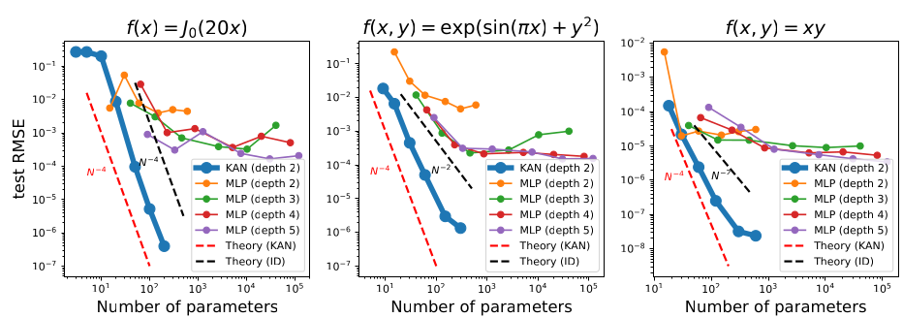
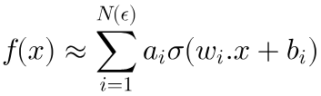
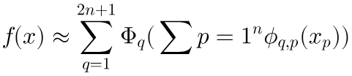
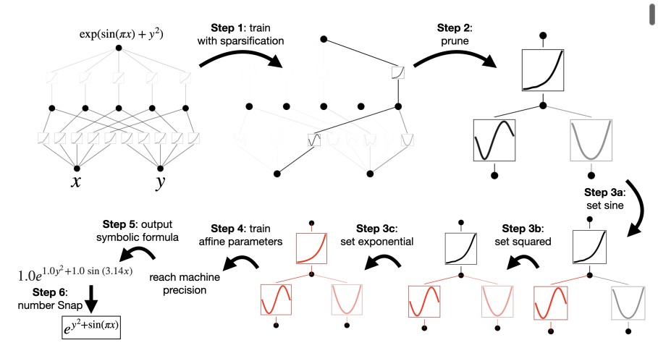
The MLP Assumption
MLP
Parameter Efficiency
Linear weights on edges
Non-linear activation on
nodes
KAN
Learnable activation
functions on edges
Nodes perform simple
summation without
non-linearitues
Interpretability & Discovery
COMPOSITIONAL
STRUCTURE
LOCAL
PLASTICITY
Hierarchical 1D Functions
Arbitrary d-dimensional
Functions
Localized B-spline updates
Global
Activations

Slide 3
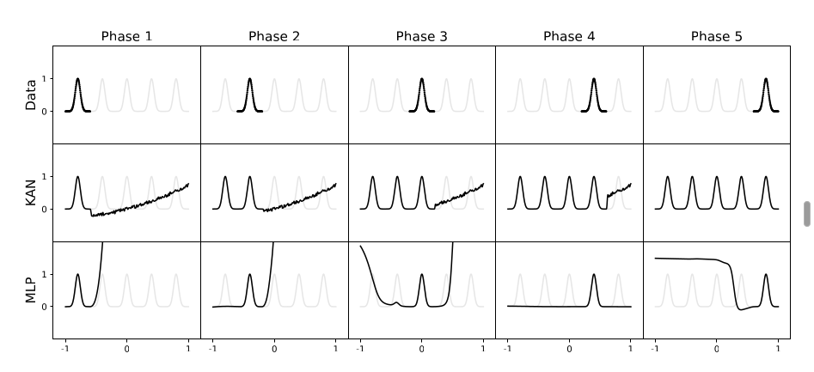
The MLP Assumption
Catastrophic Forgetting

Slide 4

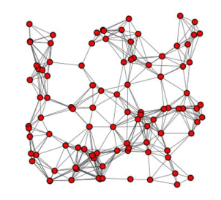
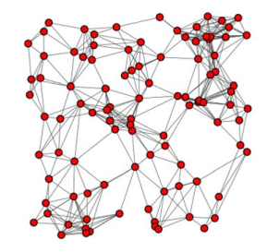
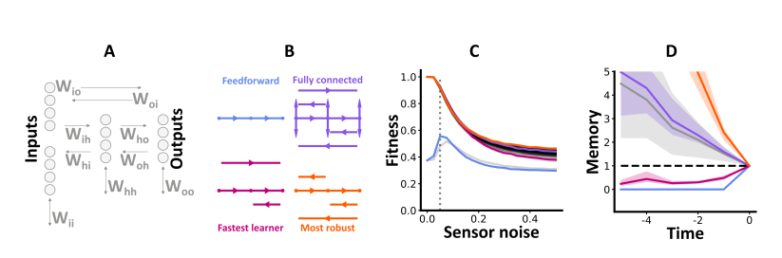
Inductive Bias & Self-Coordinating Networks
Biological & Physics Inspired Optimization
Dense and Feed-forward Style
Static Node
Adaptive Node
Self-Organizing Networks
pRNNs

Slide 5
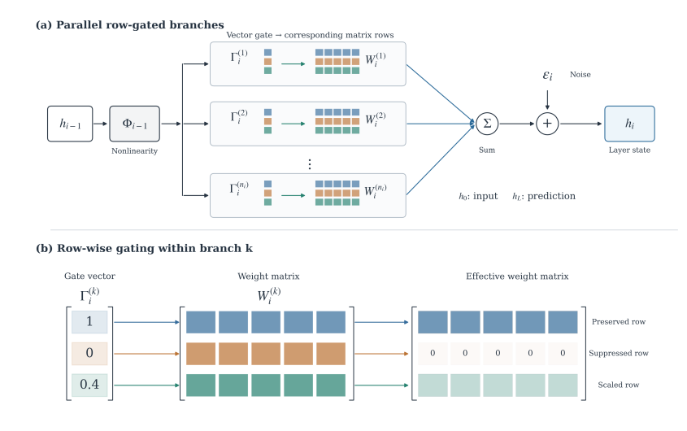
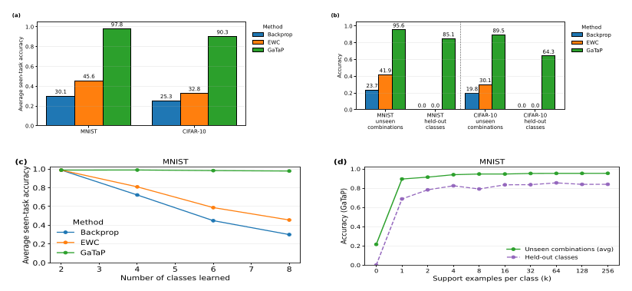
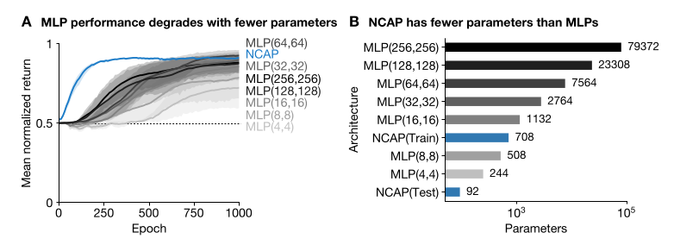
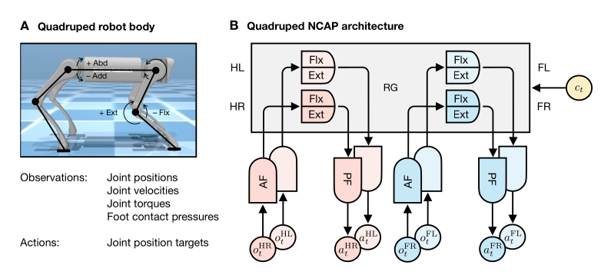
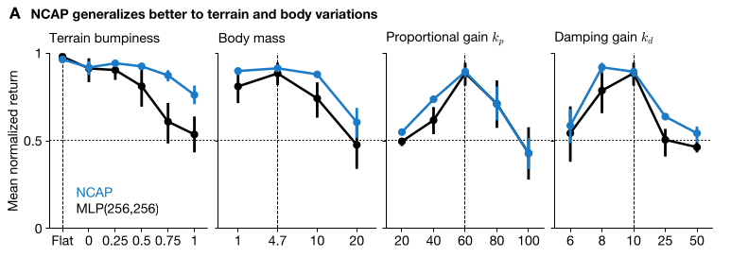
Inductive Bias & Self-Coordinating Networks
GaTaP
NCAP

Slide 6
$1Million Research
PHASE 1: PROOF OF CONCEPT (Months 0-18)
PHASE 2: STRATEGIC FLYWHEEL
(Months 18-24)
PHASE 3: LONG TERM VISION (Years 2-5)
NCAP + GaTaP:
  Show NCAP-CPG provide natural gait with 1000x parameter reduction
  Show GaTaP enables few/zero-shot terrain switching with zero catastrophic forgetting
Physical Hardware Validation:
  Deply GaTaP-NCAP controllers on Unitree A1 quadrupeds and bipedal platforms
  Demonstrate continual adaptation across changing environments
  No policy retraining/simulator training
Ultra-Low Compute (On Edge Devices):
  Run complex locomotion policies on low-cost microcontroller/edge-chips
Scale Beyond Motor-Control:
  Extend to self-coordinating, multi-agent swarms
Redundancy and Self-healing AI:
  Research re-wiring and pruning of networks
  Research adaptation to noise and hardware failures
Improve Metrics:
  Improve sample efficiency by 10x
  Improve parameter count by 100x
  zero-shot sim-to-real transfer
Raise More Funds:
"The future of AI is not larger black boxes—it is biological parsimony. By uniting neural circuit priors (NCAP) with modular continual gating (GaTaP), we build physical robots that learn like animals: stable on day one, computationally frugal, and capable of infinite lifelong adaptation."

Slide 7
$1Million Research
REFERENCES
Bhattasali, Nikhil X., et al. "Neural circuit architectural priors for quadruped locomotion." arXiv preprint arXiv:2410.07174 (2024).
Njupoun, Abdel Mfougouon, et al. "Gated Target Propagation for Compositional Generalization in Continual Learning." arXiv preprint arXiv:2610.04649 (2026).
Xu, Kunpeng, Lifei Chen, and Shengrui Wang. "Kolmogorov-arnold networks for time series: Bridging predictive power and interpretability." arXiv preprint arXiv:2406.02496 (2024).
Ghosh, Marcus, and Dan FM Goodman. "Partially recurrent neural networks maximize performance and minimize wiring."
Seyyedi, Azra, Mahdi Bohlouli, and SeyedEhsan Nedaaee Oskoee. "Self-organizing complex networks with AI-driven adaptive nodes for optimized connectivity and energy efficiency." Scientific Reports 15.1 (2025): 44527.

Slide 8
Thank You !!!

